Slide 1
Flow Visualization in the OSU
Triennial Conference on Cabin and Fire Safety
Tina Emami
October 28-31, 2019

Slide 2
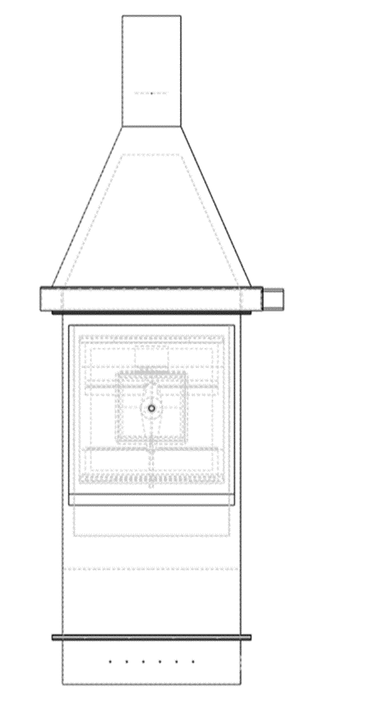
Airflow Project Goals
Create an adjustment to the current OSU apparatus in order to create an even and reproducible air flow.

Slide 3
Airflow Project Background
Two areas are being examined
Area 1: Lower plenum
Airflow is measured
Changes are made in this area
Area 2: Sample area
Airflow is measured here to understand the effect of the changes made to the lower plenum area

Slide 4
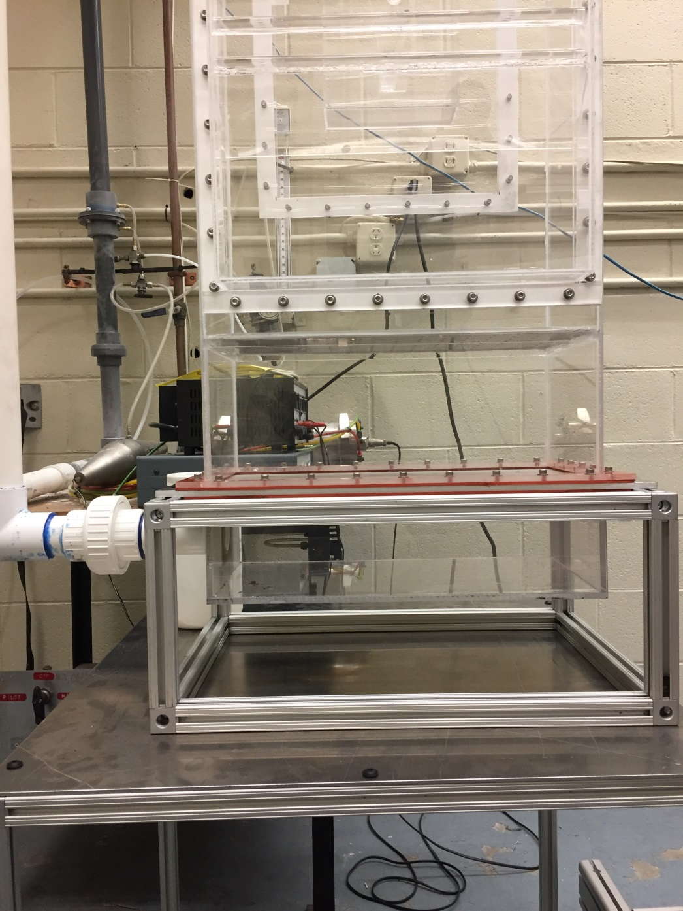
Original Test Setup
CAMERA
LASER
Chamber 1
OSU is oriented so the glow bars are facing the camera

Slide 5
Area 1 (Lower Plenum) Location Original Test Setup
The green squares in the lower plenum are the Area 1 location measurement

Slide 6
Area 1 (Lower Plenum) Original Test Setup
Results shown are averages of 500 data images

Slide 7
Area 2 Location (Near Sample)

Slide 8
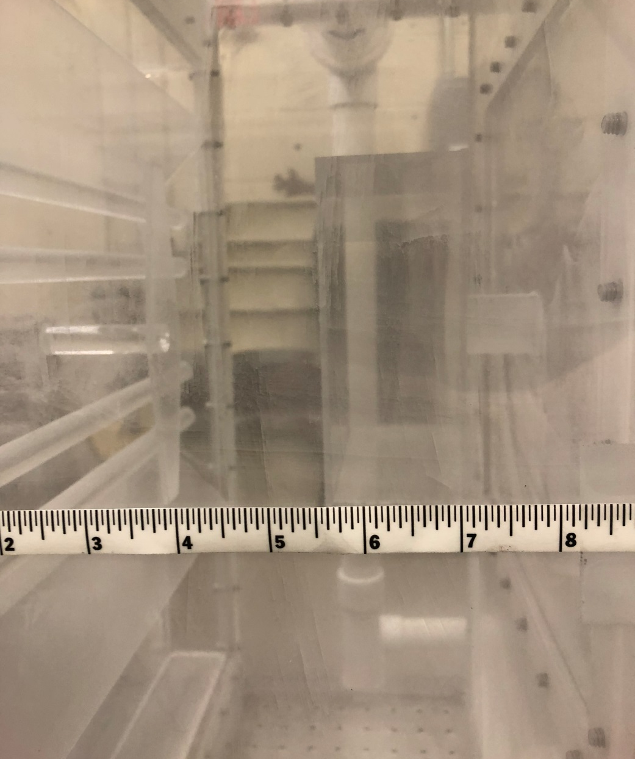
Measurement Location

Slide 9
Area 2 (Near Sample) Original OSU Setup

Slide 10
New Setup 1 Comparison Measured at Test Sample
New Set Up 1
New Test Setup 1
Original OSU Setup

Slide 11
New Setup 2 Comparison Measured at Test Sample
New Test Setup 2
Original OSU Setup

Slide 12
Reticulated Foam when inside the hot OSU

Slide 13
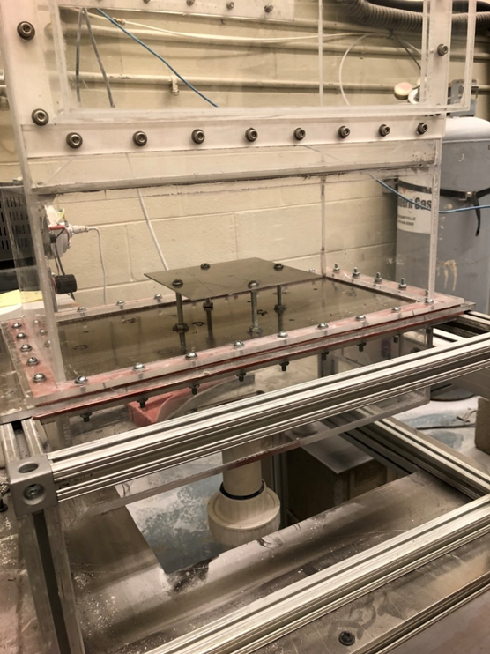
Other Concepts Studied

Slide 14
New Setup 5 Comparison Air Distribution Tube Measured at Test Sample
New Test Setup 5
Original OSU Setup

Slide 15
New Setup 5

Slide 16
New Tube Placed in OSU

Slide 17
Analyzing the New Air Distribution Tube
Airflow measurements using a vane anemometer and hot wire anemometer
Temperature readings before and during sample testing
Heat release test comparison before and after the addition of the tube

Slide 18
Preliminary Measurements
Measurements taken without any changes in a metal OSU
While the unit is cold, air velocity was measured in the OSU with a vane anemometer
Left:
0.44 m/s
Center:
0.32-0.40 m/s
Right:
0 m/s
Air
Inlet

Slide 19
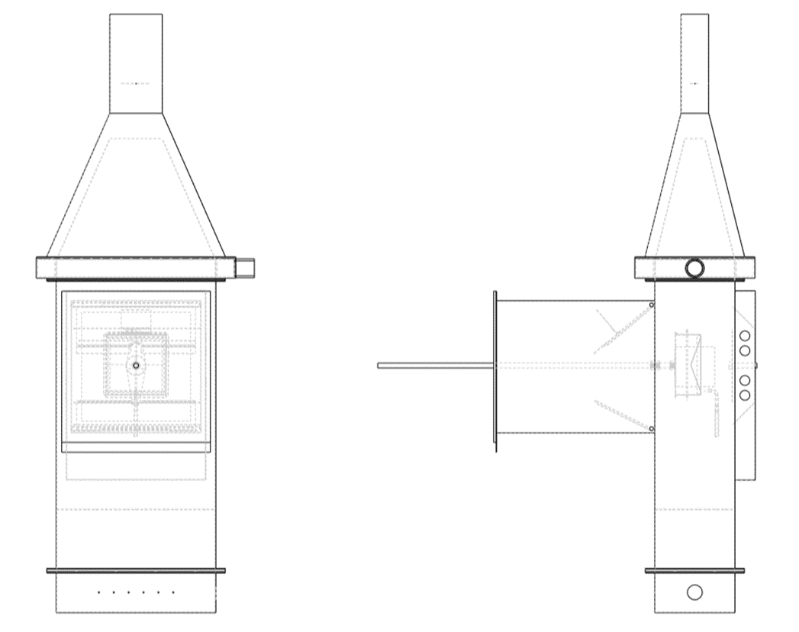
Airflow measurements with a hot wire anemometer
Simple airflow measurements were performed in a cold, metal OSU
All doors are open during measurement, because the hot wire anemometer will not allow the doors to close fully

Slide 20
Airflow measurements with a hot wire anemometer Air Distribution Tube inside OSU
Glow Bars
0.25 m/s
0.05 m/s
0.13 m/s
Viewing Window
0.18 m/s
0.20 m/s
0.11 m/s
0.25 m/s
0.28 m/s
0.40 m/s
Key
Doors
0.05 m/s
0.11 m/s
0.25 m/s
0.18 m/s
0.4 m/s

Slide 21
Baseline Tests for Temperature
Each red dot indicates a temperature measurement taken.
Each blue dot is a side view of an existing red dot, to clarify its location in space.

Slide 22
Rear Inner Cone Temperatures – Left and Right Baseline Measurement
Before adding the air distribution tube, the left and right corners of the Rear Inner Cone had an average temperature difference of 35°F.
After the air distribution tube, they have an average temperature difference of 0.35°F.
Addition of tube increased the Rear Cone temperature by 149°F on the left and 115°F on the right.

Slide 23
Forward Inner Cone Temperatures – Left and Right Baseline Measurement
Before adding the air distribution tube, the left and right corners of the Forward Inner Cone had an average temperature difference of 34°F.
After the air distribution tube, they have an average temperature difference of 1°F.
Addition of tube increased the Inner Rear Cone temperature by 159°F on the left and 126°F on the right.

Slide 24
Inner Cone Temperatures – Left and Right Baseline Measurement
Before the air distribution tube, the four corners of the inner cone were all averaged at 456°F with a standard deviation of 23.1%
The center of the cone read an average of 422°F
After the addition of the air distribution tube, the four corners of the inner cone are all averaged at 593°F with a standard deviation of 5.24%
The center of the cone read an average of 588°F
The result shows a more stable and uniform temperature reading,
but at a significant increase in temperature.

Slide 25
Mask Temperature Baseline Measurement
After the addition of the air distribution tube, the average center mask temperature decreased by 62°F.

Slide 26
Baseline Tests in the OSU
Four different honeycomb samples were tested in the OSU for comparative purposes
Each sample was tested three times
Sample | Thickness
Sample A | 1/8 in
Sample B | 11/16 in, white decorative
Sample C | 7/8 in, no decorative
Sample D | 1/4 in, white decorative

Slide 27
Mask Temperature Samples A and B

Slide 28
Exhaust Air Temperature – Samples A and B
Sample A and B were tested before and after the air distribution tube was placed.
After the addition of the air distribution tube, the exhaust air temperature increased by 24°F for sample A and 23°F for sample B

Slide 29
Testing Sample A – Heat Release
 | Pre Air Dist. Tube | Post Air Dist. Tube
2 min. Total Heat Release kW min/m^2 | 33.30 | 33.27
Peak Heat Release kW/m^2 | 44.93 | 48.11

Slide 30
Testing Sample B – Heat Release
 | Pre Air Dist. Tube | Post Air Dist. Tube
2 min. Total Heat Release kW min/m^2 | 37.18 | 44.64
Peak Heat Release kW/m^2 | 39.01 | 39.60

Slide 31
Summary of Results
The cone now has an overall stable and uniform temperature reading throughout but at the cost of a significantly hotter temperature.
The exhaust temperatures increased while the temperature in the mask area decreased.
These bring us to the educated guess that the air velocity near the sample holder actually did decrease.
The 2 minute Total Heat Release increased for every sample except sample A which stayed the same.
The Peak Heat Release varied throughout the tests.
Samples B, C, and D had worse variability in their Heat Release than they did before the Air Distribution Tube.

Slide 32
Problems encountered
Plexiglas could be affecting these readings through static electricity
The velocity readings were shown much slower than what was measured with anemometers in the traditional OSU
Since the PIV was displaying the average velocity, and there was a lot of circulation, it could have been measuring upwards flow half the time and downwards flow half the time, averaging to very slow final speeds.

Slide 33
Future Work
Take out the air distribution tube and re-measure the original OSU with the hot wire anemometer to see if there are any differences from the first time
Will continue this work with hot wire anemometers and larger scale flow measurements and analysis

Slide 34
Questions or Comments?
Tina Emami
FAA William J. Hughes Technical Center
ANG-E212 Materials Fire Test
Building 275
Atlantic City Int’l Airport, NJ 08405
tina.emami@faa.gov
609-485-4277

